Slide 1


QUERY-CONDITIONED DEEP LEARNING FOR ADAPTIVE MULTI-SOURCE MUSIC SEPARATION
Course Title: Deep Learning
Course Code: 22AIE302
Department: AIE
Achintya TR-CH.SC.U4AIE24003
BJ Kiranesh - CH.SC.U4AIE24006
Hithesh R - CH.SC.U4AIE24027
Parinitha K - CH.SC.U4AIE24052
Notes:
Introduce the project and the team. One sentence: we built a system that first detects which instruments are in a song, then extracts exactly the ones the user selects, including Carnatic instruments such as mridangam and violin that existing pretrained separators cannot isolate.

Slide 2
Problem & Motivation
THE PROBLEM
OUR APPROACH
Pretrained separators return a fixed split: vocals, drums, bass and “other”.
Carnatic instruments — mridangam, ghatam, violin — fall outside every pretrained stem set.
Listeners usually want one specific instrument, with everything else removed.
A trained detector finds which instruments are present; one query-conditioned network then extracts exactly the stems the user selects.
8 stems · 2 musical traditions · 1 conditioned model
WHY IT MATTERS
Typical output: Vocals + Drums + Bass + Other
Opens instrument-level separation to Indian classical recordings — useful for practice, transcription and remixing.
Notes:
Pretrained separators output a fixed split (vocals, drums, bass, other). Indian classical instruments are not in any of those sets. Users generally want one instrument and everything else gone. Our answer: a detector plus one query-conditioned separator.

Slide 3
Objectives
1
2
3
4
Detect
Separate
Cover Carnatic
Suppress leakage
Detect six trained classes; estimate guitar and piano from the Demucs backend.
Extract any selected stem with a single query-conditioned model.
Support mridangam, violin and ghatam alongside the Western stems.
Suppress unselected instruments and measure the leakage.
Macro-F1 ≈ 0.80
Val SI-SDR +2.5 dB
+0.8 / +2.8 / +4.4 dB vs Demucs
Up to 28 dB SIR
Notes:
Four objectives: detect, separate, cover Carnatic instruments, and suppress leakage. Each one is measured later in the results section.

Slide 4
System Overview
Audio
mixture
→
Stem detector
CNN
→
User selects
stems
→
Separation
→
Clean
output
DETECT
SEPARATE
CLEAN UP
6 s windows, logits averaged over the song
Per-class thresholds tuned on validation
Trained on real + synthetic mixtures
Western stems: pretrained Demucs backend
Carnatic stems: our trained U-Net
Stem ID conditions the network (FiLM)
Every time-frequency bin is shared by all sources
Unselected stems are actively suppressed
Output sums back to the original mixture
Notes:
End to end: audio goes into the stem detector; the user picks stems; separation uses the pretrained Demucs-6 backend for Western stems and our own U-Net for Carnatic stems; a competitive mask removes bleed.

Slide 5
Datasets
MUSDB18-HQ
SARAGA CARNATIC
100
168
tracks (+ 50 held-out test)
multitrack concert recordings
Stems: vocals, drums, bass, other
Split: 84 train / 16 validation
44.1 kHz stereo → 22.05 kHz mono
Stems: vocal, violin, mridangam (L+R), ghatam
Split: 132 train / 36 validation (by track)
Ghatam present in only 46 tracks
Notes:
Two corpora. MUSDB18-HQ gives Western stems. Saraga Carnatic gives multitrack concert recordings with vocal, violin, mridangam and ghatam stems. Splits are by track so there is no leakage between train and validation.

Slide 6
Data Audit: Key Findings
1
Mixes ≠ stems
2
Validation leak
3
No guitar / piano labels
Even an ideal mask scored −15 to −23 dB SI-SDR: the released Saraga mix is not waveform-consistent with its mic stems.
Fix: train on the exact sum of stems (ceiling rose to +3.5 … +9.7 dB).
All 16 MUSDB “valid” tracks were also in “train”, so reported scores were measured on training data.
Fix: removed from training; scores are now on unseen tracks.
MUSDB provides a single “other” stem, so guitar and piano ground truth does not exist.
Fix: those two labels are masked out of the detector loss.
Result of data fixes alone: validation SI-SDR −8.5 dB → +1.8 dB, before any change to the network.
Notes:
Before changing the network we audited the data. Three problems explained most of the early failures. Fixing them alone moved validation SI-SDR from about -8.5 dB to +1.8 dB.

Slide 7
Stem Detector
ARCHITECTURE
F1 PER INSTRUMENT (validation)
Input: 128-band log-mel, 6 s windows
4 conv blocks (32 → 256 ch) + global pooling + 2 FC layers
8 sigmoid outputs, label-masked weighted BCE
Trained on real + synthetic cross-corpus mixtures
0.42 M parameters · per-class tuned thresholds
150 epochs · batch 16 · AdamW
Macro-F1 ≈ 0.80 · guitar / piano decided by Demucs energy
Notes:
A small CNN on log-mel spectrograms. Guitar and piano outputs are not trusted because no clean labels exist. The per-class F1 on the right is on validation tracks at the tuned threshold; macro-F1 is about 0.80.

Slide 8
Query-Conditioned Separator
Mixture
|STFT|
Log
compression
Encoder ×4
+ FiLM
Decoder ×4
+ skips
Sigmoid
mask
× mixture
+ iSTFT
THE QUERY
THE OUTPUT
Stem ID (0–7) → learned 64-d embedding → FiLM γ, β scale and shift the features at every encoder level.
A mask in [0, 1] over the mixture spectrogram; it is also trained to return silence when the requested stem is absent.
8.8 M
trainable parameters
6 s @ 22.05 kHz
training clips
1024 / 256
STFT window / hop
Notes:
A U-Net on the magnitude spectrogram. The stem ID is embedded and drives FiLM layers at every encoder level, so one network can extract any of the 8 instruments. The output is a soft mask applied to the mixture.

Slide 9
Separation Results
VALIDATION SI-SDR (dB) — RAW MIXTURE vs OUR SEPARATOR
+2.5 dB
best validation SI-SDR (overall)
5.6 / 5.2 dB
Carnatic vocals / mridangam
Ghatam omitted: the model returns silence. Guitar and piano omitted: no separate ground truth.
Notes:
Validation SI-SDR of our separator against the raw mixture, per stem. The model improves on the mixture for every stem except guitar, and Carnatic vocals and mridangam are the strongest. Ghatam is omitted: the model returns silence because only 46 training tracks contain it.

Slide 10
Validation Progress
BEST VALIDATION SI-SDR (dB) AT EACH STAGE
−8.48
Retrained after removing the leak; Saraga targets still misaligned
+1.81
Saraga trained on the exact sum of stems
+2.15
120 s per MUSDB track, 60 s per Saraga track
+2.53
8.8 M-parameter model, 150 s / 90 s per track
Notes:
How validation SI-SDR improved. The biggest jump came from fixing the data, not from changing the network.

Slide 11
Carnatic Stems vs Pretrained
SI-SDR (dB) vs THE TRUE INSTRUMENT STEM
+0.8 dB
vocals
+2.8 dB
violin
+4.4 dB
mridangam — Demucs has no such class
12 Saraga validation tracks, 20 s windows, full inference path; scoring favours Demucs. Absolute values differ from the 6 s validation clips on the Results slide.
Notes:
The key comparison. We scored the strongest pretrained separator (Demucs 6-source) on the same Carnatic audio, giving it its best-matching output of the six. Our model is ahead on all three, and the gap is largest for mridangam, which Demucs has no class for.

Slide 12
Suppressing Unselected Stems
SIR (dB) — HIGHER = LESS BLEED FROM OTHER STEMS
+22 dB
less bleed in the guitar + piano output
28 dB
bleed suppression for vocals and drums
4 MUSDB test tracks, 40 s excerpts. Guitar/piano output includes the remaining accompaniment.
Notes:
Signal-to-interference ratio measures how much of the unselected stems remains. The competitive filter plus the stronger backend removes most of it; for guitar plus piano the improvement is more than 20 dB.

Slide 13
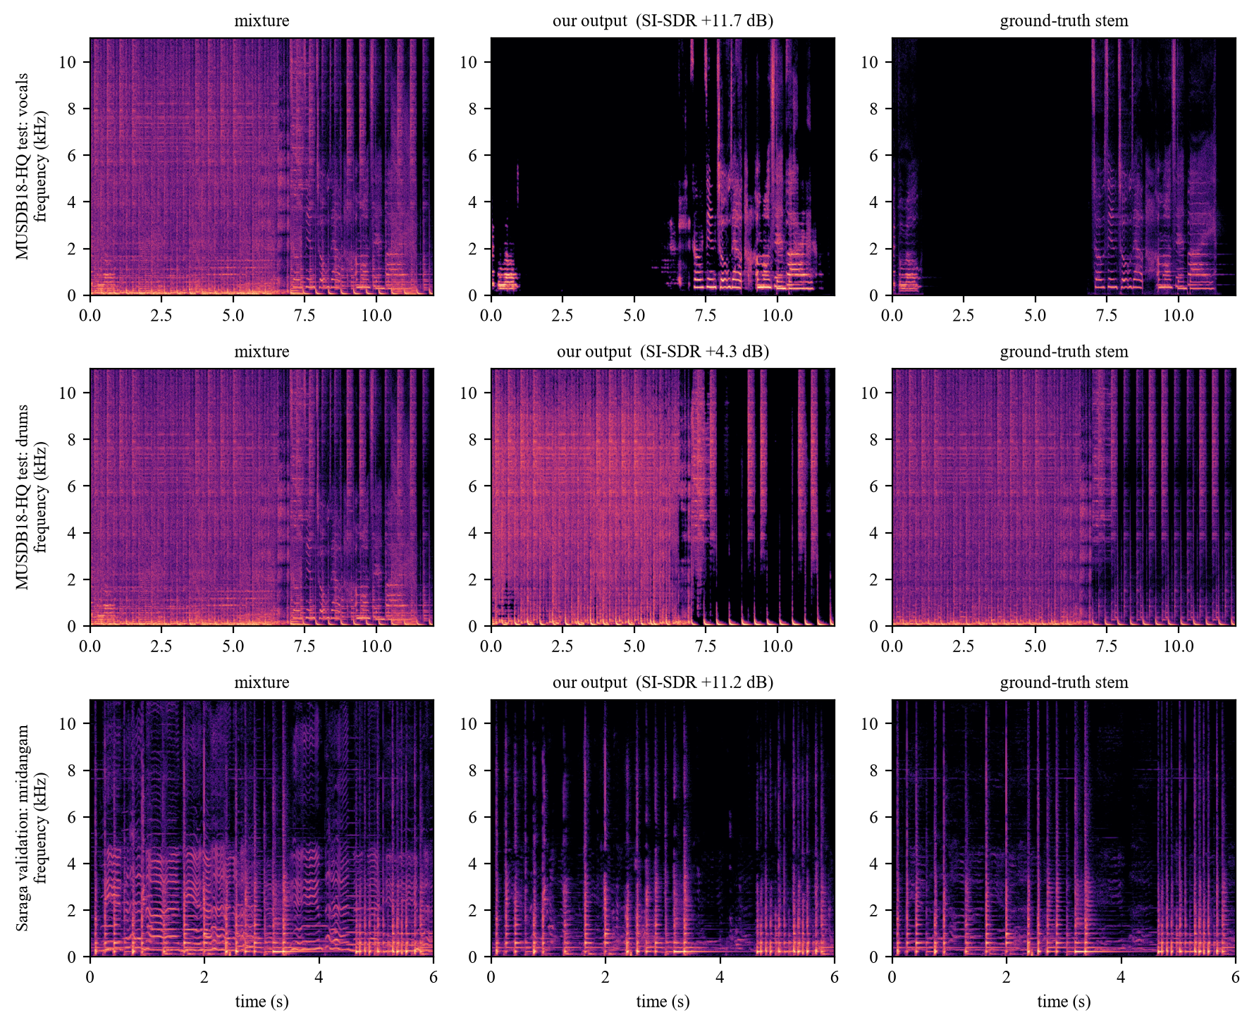
Example Outputs
11.7 dB
SI-SDR, vocals (MUSDB test excerpt)
4.3 dB
SI-SDR, drums (MUSDB test excerpt)
11.2 dB
SI-SDR, mridangam (Saraga validation clip)
Real clips, not chosen for quality. SI-SDR is against the true stem. The mridangam clip is far above the 5.2 dB validation average.
Notes:
Three real clips from the final system. Vocals and drums come from the pretrained backend through the competitive mask, and mridangam comes from our trained U-Net. The clips were taken as they came: the second MUSDB test track at 60 to 72 seconds, and the first Saraga validation clip that has audible mridangam. They are single examples, and the mridangam clip scores well above the validation average of 5.2 dB, so quote the averages from the earlier slides, not these numbers.

Slide 14
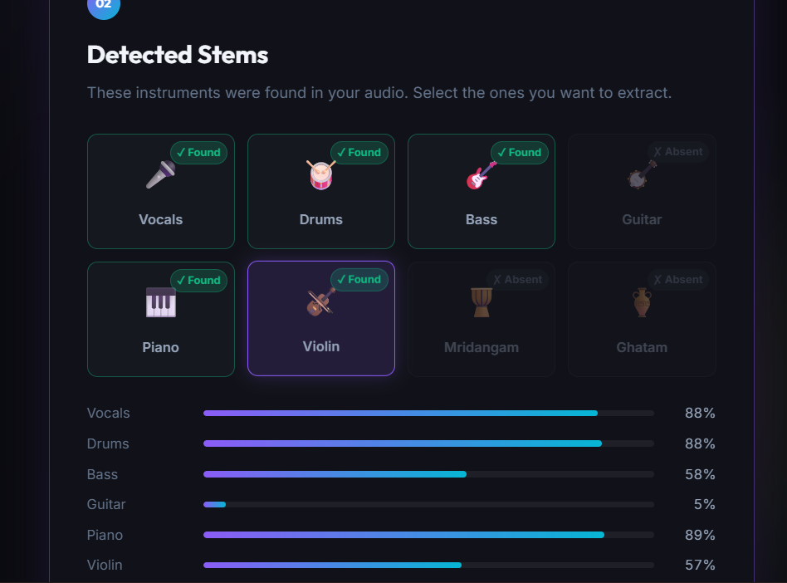
Web Application
1
Upload audio or a video file
2
Detect stems (with probabilities)
3
Select any combination
4
Separate the selection
5
A/B compare, or rebuild the video
Flask · PyTorch · WaveSurfer.js
Notes:
The Flask front end runs the same pipeline: upload, detect, select any combination, separate, and compare against the original with synchronized A/B playback.

Slide 15
Contributions
1
Carnatic coverage
2
One conditioned model
Mridangam, violin and ghatam extracted by a trained model; +2.8 dB (violin) and +4.4 dB (mridangam) over the best pretrained output.
A single query-conditioned U-Net serves all 8 stems, trained with absent-query examples so it returns silence for missing instruments.
3
Robust detector
4
Data audit
Multi-label CNN with synthetic cross-corpus mixing and label masking: macro-F1 ≈ 0.80, no dataset shortcut.
Found unusable Saraga mixes and a validation leak; fixing them took validation SI-SDR from −8.5 dB to +2.5 dB.
Pretrained: Demucs-6 backend for Western stems only. Trained here: detector + U-Net for all 8 stems.
Notes:
Four contributions. Carnatic coverage is the headline and is backed by the comparison on the earlier slide. State the pretrained backend plainly: it is used for Western stems only.

Slide 16
Limitations & Future Work
LIMITATIONS
FUTURE WORK
Ghatam: only 46 bleed-heavy tracks — returns silence
Violin ≈ 1 dB; absent violin and mridangam still audible
Guitar and piano: no separate ground truth, approximate output
Mask oracle reference ≈ 4–10 dB (mixture phase reused)
Real console mixes differ from stem-sum training audio
Complex-valued or waveform-domain separator
More Carnatic recordings
Fine-tune on real concert mixes
Listening tests alongside SI-SDR
Real-time, streaming inference
Notes:
Be upfront about limits: ghatam is data-limited, violin is modest, and a magnitude-mask approach has a ceiling. Future work addresses each of these.

Slide 17
Conclusion
One detector (six trained classes) and one query-conditioned separator serve eight query classes.
On Carnatic recordings the trained model beats the strongest pretrained separator by +0.8 to +4.4 dB.
A competitive filter reduces leakage (SIR 11–28 dB); residual interference remains.
Auditing the data — not enlarging the network — delivered the largest gain.
Takeaway: instrument-level separation for Indian classical music, now measurable.
Notes:
Close by restating the three results: a working detect-then-separate system, a measured advantage on Carnatic instruments, and a data audit that changed the outcome.

Slide 18
THANK YOU

